Slide 1
How to add new films

Slide 2
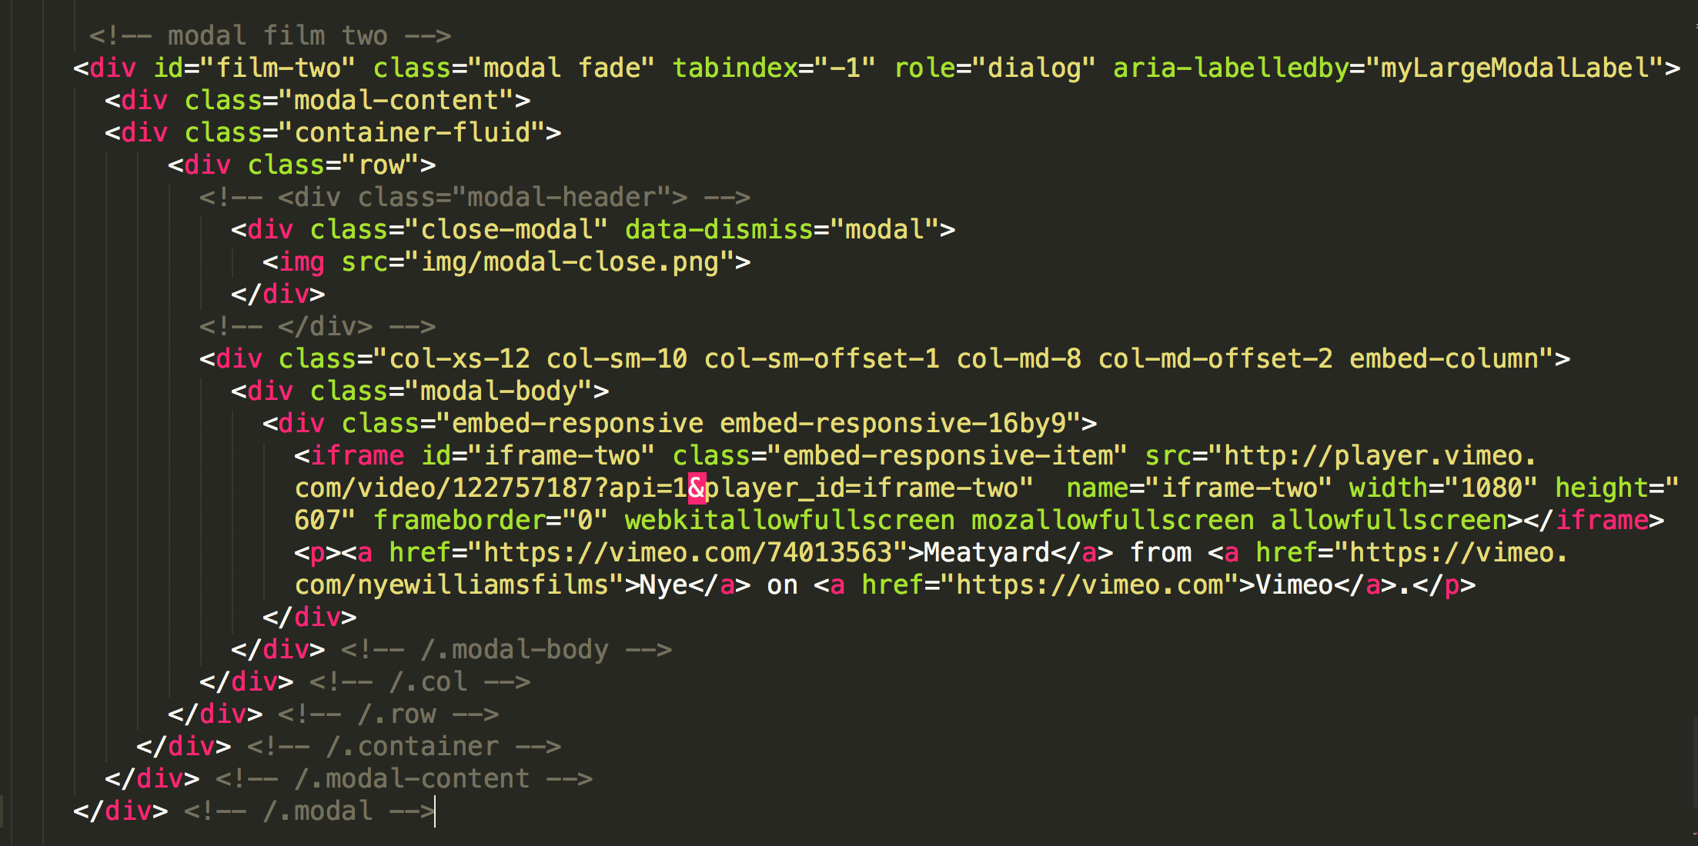
Copy and paste the whole modal at the bottom of the page

Slide 3
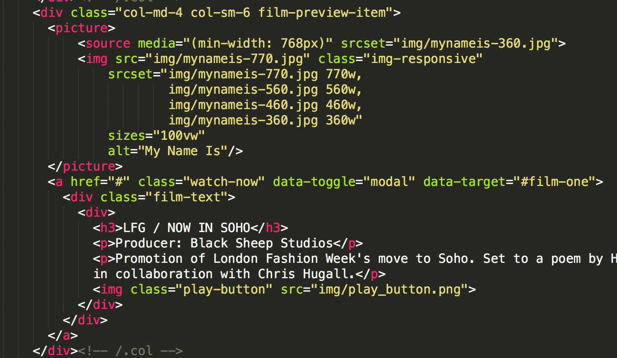
Change the id (this is the thing the link is looking for)
Scroll back up the page and change the ‘data target’
to match the id

Slide 4
Scroll back down to the modal.
Find the ‘iframe’.
Add your new embed code.
Add this text after the embed code
“?api=1&player_id=iframe-two”
Change the ‘id’ to something unique in both places.
THEY MUST BE UNIQUE AND MATCH
You can also change the name

